Slide 1
Strategies for Utility Owner Participation
in
Transportation Projects

Slide 2
Why is It Important?
Difficulty to locate utility facilities/identify conflicts
No legal mechanism to encourage utility owners to start participating early in the PDP
Utility owners usually interested after 60% design
Delays in project development and delivery
Unanticipated utility adjustments
Notes:
A 2002 survey of state departments of transportation (DOTs), highway contractors, design consultants, and others identified utility adjustments as the most frequent reason for delays in highway construction. Delays and inefficiencies in utility-related activities have a tendency to proliferate into project letting and even construction, frequently resulting in higher bids, change orders and/or damage or delay claims, litigation by utility owners or agencies, safety concerns at the job site, frustration of the traveling public, and negative public perception about the project.

Slide 3
Research Project 0-6624 Deliverables
0-6624-P1: Guidebook and Training Materials
  Strategies for earlier, more effective utility owner participation in the PDP
0-6624-1: Research Report
0-6624-S: Summary Report
Notes:
Project 0-6624 resulted in three deliverables:
0-6624-P1: Guidebook and training materials (including this presentation).
0-6624-1: Research report.
0-6624-S: Summary report.

Slide 4
Strategies to Encourage and Facilitate Utility Participation
1. Modernization of the utility process
2. Utility conflict matrix approach
3. Streamlining and standardization of utility
cost data submissions
4. Core skill training on utility topics
Notes:
Project 0-6624 resulted in four strategies that reflect the highest priorities based on stakeholder inputs:
Modernization of the utility process at TxDOT.
Use of utility conflict matrices and associated procedures.
Streamlining and standardization of utility cost data submissions and reimbursement process.
Core skill training on utility topics.

Slide 5
Modernization OF THE UTILITY PROCESS
Strategy 1

Slide 6
Current Utility Process
According to the ROW Utility Manual:
  Utility Cooperative Management Process – UCMP (“the process”)
  Utility adjustment subprocess (“the subprocess”)
    Three adjustment procedures – with diagrams:
      Federal Utility Procedure (FUP)
      State Utility Procedure (FUP)
      Local Utility Procedure (LUP)
    One adjustment procedure – without a diagram:
      Non-Reimbursable Procedure
Notes:
The ROW Utility Manual describes a utility cooperative management process (UCMP) (called “the process”) that TxDOT encourages districts to use for managing utility-related activities. A component of the UCMP is a utility adjustment sub process (called “the sub process”) that describes utility adjustment activities in more detail. The sub process includes three major utility adjustment procedures:
Federal Utility Procedure (FUP), which applies in situations that include federal fund participation.
State Utility Procedure (SUP), which applies in situations that do not involve federal fund participation and TxDOT coordinates adjustments with utility owners.
Local Utility Procedure (LUP), which applies in situations that do not involve federal fund participation and an LPA coordinates adjustments with utility owners.
The ROW Utility Manual also mentions a Non-Reimbursable Procedure, which applies in the case of non-reimbursable utility adjustments.

Slide 7
Issues
Discrepancies between documented process and actual practice
Different practices at districts cause difficulties for utility owners spanning multiple districts
Written documentation
  Complex and difficult to follow
  Lacks flexibility
  Needs updating
Notes:
There is a need to modernize the utility process at TxDOT. First, there are discrepancies between the manual and the actual practice at the district and division levels. Second, there are difference in the way districts carry out the utility process, which cause difficulties for utility owners that cover multiple TxDOT districts. Third, stakeholders indicated that the utility process described in the documentation is too complex and difficult to follow, lacks flexibility, and needs updating.

Slide 8
Updated Utility Process
Process depiction using Business Process Model and Notation (BPMN)
Updated descriptions of activities
Three models with increasing detail:
  Level 1: High-level depiction of entire PDP
  Level 2: Intermediate-level depiction of the PDP
  Level 3: Level 2 with a more detailed view of the utility process
Notes:
In response to stakeholder feedback, the researchers developed a modernized view of the utility process at TxDOT. The researchers used a standard business modeling tool called the Business Process Model and Notation (BPMN) to develop the a graphical depiction of the utility process, along with written descriptions of major activities. Using BPMN enabled the use of swim lanes to group activities according to specific functions or specialties, while facilitating the development of more detailed (or “zoomed in”) views as needed.

Slide 9
Project Development and Delivery Process
Planning and programming
Preliminary design
Detailed design
Letting
Construction
Post construction
Notes:
In the three models, project development activities are generally organized chronologically, consistent with the six major phases in the project development and delivery process.

Slide 10
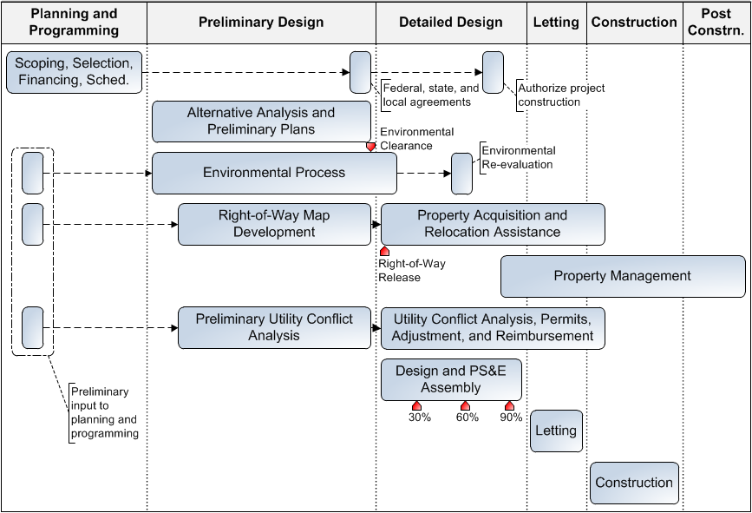
Level 1 Model
Open PDF File
Notes:
The Level 1 model provides a high-level view of the entire project development and delivery process. The model considers both phases and functional areas (represented by individual bars) and is suitable for general presentations and handouts. At 100-percent scale, the page size of the Level 1 diagram is 8.5 × 11 inches.
Clicking the Open PDF file button loads a PDF file that includes the Level 1, Level 2, and Level 3 diagrams. This file is located in the \Strategy 1 - Modernization of the Utility Process\ folder. The folder also includes the model in Microsoft® Visio® format.

Slide 11
Level 2 Model
Open PDF File
Notes:
The Level 2 model provides an intermediate level of detail of the entire project development and delivery process. At 100-percent scale, the page size of the Level 2 diagram is 24 × 36 inches. The purpose of the model is to provide more information about the entire process than Level 1, with some emphasis on right-of-way and utility activities, and how these activities relate to the rest of the project development and delivery process.
Clicking the Open PDF file button loads a PDF file that includes the Level 1, Level 2, and Level 3 diagrams. This file is located in the \Strategy 1 - Modernization of the Utility Process\ folder. The folder also includes the model in Microsoft Visio format.
The following slides provide more information about the diagram structure and content.

Slide 12
Level 2 Model
Activities arranged in “pools”
  Pools represent groups of activities with similar functions
Pools divided into “lanes” as needed
Pool with a red outline is the utility pool
Outside utility pool, activity boxes with a red outline are utility-related
Notes:
In the Level 2 model, activities are arranged in “pools” that represent groups of activities with similar functions, which are further broken down into “lanes” as needed. The pool highlighted with a red outline represents the utility pool (“Utility, Conflict Analysis, Permits, Adjustments, and Reimbursement”). Outside this pool, activity boxes with a red outline represent project development process activities that are typically utility-related.

Slide 13
Level 2 Model Pools and Lanes
Scoping, selection, financing, and scheduling
Alternative analysis and preliminary plans
Environmental process
Right of way map, authorization to acquire property, property acquisition, and relocation assistance
  Acquisition
  Relocation assistance advisory
Notes:
The Level 2 model includes the following major phases or functional areas:
Scoping, selection, financing, and scheduling.
Alternative analysis and preliminary plans.
Environmental process.
Right of way map, authorization to acquire property, property acquisition, and relocation assistance, which is further divided into two lanes:
Acquisition.
Relocation assistance advisory.
Property management.
Utility conflict analysis, permits, adjustments, and reimbursement.
Design and PS&E assembly.
Letting.
Construction.

Slide 14
Level 2 Model Pools and Lanes
Property management
Utility conflict analysis, permits, adjustments, and reimbursement
Design and PS&E assembly
Letting
Construction
Notes:
The Level 2 model includes the following major phases or functional areas:
Scoping, selection, financing, and scheduling.
Alternative analysis and preliminary plans.
Environmental process.
Right of way map, authorization to acquire property, property acquisition, and relocation assistance, which is further divided into two lanes:
Acquisition.
Relocation assistance advisory.
Property management.
Utility conflict analysis, permits, adjustments, and reimbursement.
Design and PS&E assembly.
Letting.
Construction.

Slide 15
Level 3 Model
Open PDF File
Notes:
The Level 3 model is essentially the same as the Level 2 model, except that it provides a more detailed view of utility data collection, coordination, and adjustment activities. At 100-percent scale, the page size of the Level 3 diagram is 36 x 48 inches.
Clicking the Open PDF file button loads a PDF file that includes the Level 1, Level 2, and Level 3 diagrams. This file is located in the \Strategy 1 - Modernization of the Utility Process\ folder. The folder also includes the model in Microsoft Visio format.

Slide 16
Level 3 Model Pools and Lanes
Same pools as Level 2 model
Outside of utility pool, activities same as Level 2 model
Additional lanes for utility conflict analysis, permits, adjustments, and reimbursement
  Utility data collection and assessment
  Utility coordination
  Utility owner
Notes:
The level 3 model contains the same pools as level 2 model. For Level 3, the Utility Conflict Analysis, Permits, Adjustments, and Reimbursement pool is divided into three lanes: Utility Data Collection and Assessment, Utility Coordination, and Utility Owner. With a few exceptions, activities in other pools and lanes are shown at the same level of detail as in the Level 2 model.

Slide 17
Strategy Implementation Plan
Identify leaders and assemble implementation team
Schedule workshops to disseminate updated utility process
Update TxDOT manuals (i.e., ROW Utility, PS&E Preparation, and PDP manuals)
Monitor implementation by conducting acceptability surveys at various intervals
Notes:
The following are recommendations to implement the modernized depiction of the utility process at TxDOT:
Identify leaders for the implementation and assemble an implementation team. The Right of Way Division can be the main champion and office of primary responsibility for the implementation.
Schedule workshops throughout the state to disseminate the updated utility process.
Update the ROW Utility Manual by inserting and/or replacing content, as described in the guidebook..
Update the PS&E Preparation Manual to reflect changes made to the ROW Utility Manual.
Update the Project Development Process Manual to reflect changes made to the ROW Utility Manual.
Monitor the implementation of the strategy by conducting acceptability surveys throughout the implementation period.

Slide 18
Strategy Benefits
Modern, user-friendly representation of the utility process
Activities and descriptions that correspond to the process districts actually use
Provides information that users are more likely to understand and follow
Notes:
Anticipated benefits of the strategy include the following:
Modern, user-friendly representation of the utility process. The updated depiction of the utility process uses clear, easy-to-follow graphical representations of the process complemented by summarized descriptions of critical activities. It eliminates the use of process/sub process diagrams and activity descriptions that make understanding the utility process difficult.
Activities and activity descriptions that correspond to the process that districts actually use. The new depiction corrects inaccuracies or deficiencies in the current documentation as well as inserts activities that are part of actual practice or that have been recommended as improvements or optimizations of the current practice.
Provides information that users are more likely to understand and follow, therefore promoting a more effective participation by utility owners in the project development process.

Slide 19
Potential Challenges
Users’ perception of benefits and commitment to new process
Staffing and financial resources required for changing practices
TxDOT might not have the necessary tools to implement the strategy
  Update manuals, conduct workshops, monitor acceptability
Notes:
Potential impediments for the implementation of this strategy include:
Users might decide to ignore the updated utility process in favor of existing practices they have used for years.
Staffing and financial resources required for changing current practices.
TxDOT might not have the necessary tools to implement the strategy.

Slide 20
Utility Conflict Matrix Approach
Strategy 2

Slide 21
Strategies to Encourage and Facilitate Utility Participation
1. Modernization of the utility process
2. Utility conflict matrix approach
3. Streamlining and standardization of utility
cost data submissions
4. Core skill training on utility topics

Slide 22
Utility Conflict Matrices (UCMs)
Utility-related activities involve enormous amount of data and supporting documents
UCMs enable users to organize and track utility conflict data effectively
UCMs can support a wide range of related processes
Notes:
Utility-related activities in the project development process involve the production and exchange of enormous amount of data and supporting documents, including schematics, design files, agreements, and certifications. A critical component of this process is how to document and manage utility conflict data effectively. Utility conflict tables, also known as utility conflict matrices (UCMs) or utility conflict lists, enable users to organize and track utility conflict data. In practice, these tables or matrices support a wide range of related processes, including conflict analyses, utility agreement development, construction letting, as well as utility relocation scheduling, billings, and payments.

Slide 23
SHRP 2 R15-B Research Products
Product 1: Compact, standalone UCM
Product 2: Utility conflict data model
and database
Product 3: One-day UCM training course
Notes:
As part of the Strategic Highway Research Program (SHRP) 2 Research Project R15-B “Identification of Utility Conflict and Solutions,” TTI researchers conducted research to review the state-of-the-practice around the country, identify recommendations for best practices, develop and test a prototype UCM concept, and develop training materials and implementation guidelines. the research resulted in the following products:
Product 1: Standalone UCM spreadsheet. This is a standalone product in Microsoft Excel® format, which includes a main utility conflict table and a supporting worksheet to analyze utility conflict resolution strategies.
Product 2: Utility conflict data model and database. This standalone product is a scalable UCM representation that facilitates managing utility conflicts in a database environment.
Product 3: UCM training course and course materials. This deliverable is a one-day training course that provides an overview of utility conflict issues and use of the UCM. The one-day UCM training course is divided into six lessons, designed for a total of seven hours and 15 minutes of instruction, from 8:30 AM to 3:45 PM.

Slide 24
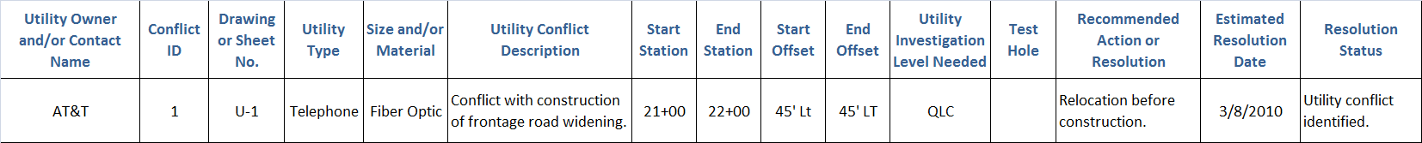
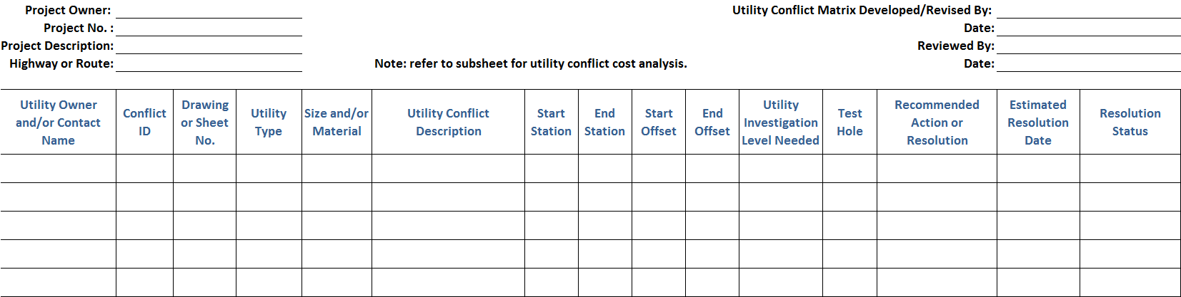
Product 1: Utility Conflict Matrix
Open PDF File
MS Excel format, includes drop-down lists
UCM spreadsheet is the product
Notes:
The Excel UCM version includes four worksheets: the main UCM, the cost estimate analysis, column or field definitions, and drop-down lists to standardize the population of certain columns in the main UCM. The UCM could be used in a number of ways to support the utility conflict management process. It could provide a simple, convenient mechanism to list all utility conflicts associated with a project. However, for maximum benefit, the UCM could be used in conjunction with the cost estimate analysis sheet to identify, document, and track optimum utility conflict resolution strategies.
Clicking the Open PDF file button loads a PDF file representation of the UCM. This file is located in the \Strategy 2 - Utility Conflict Matrix Approach\ folder. The folder also includes the UCM in Microsoft Excel® format.

Slide 25
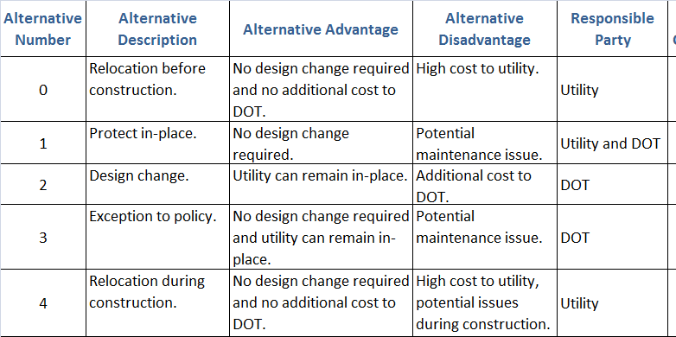
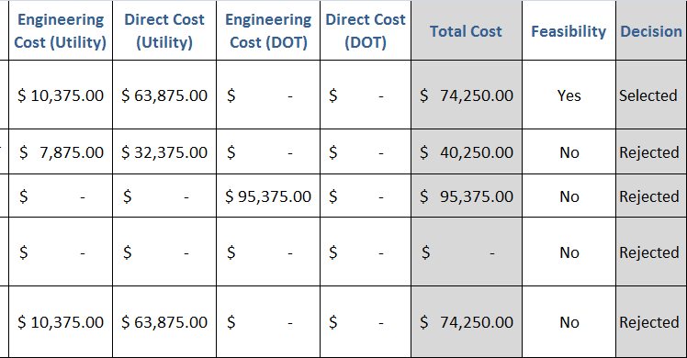
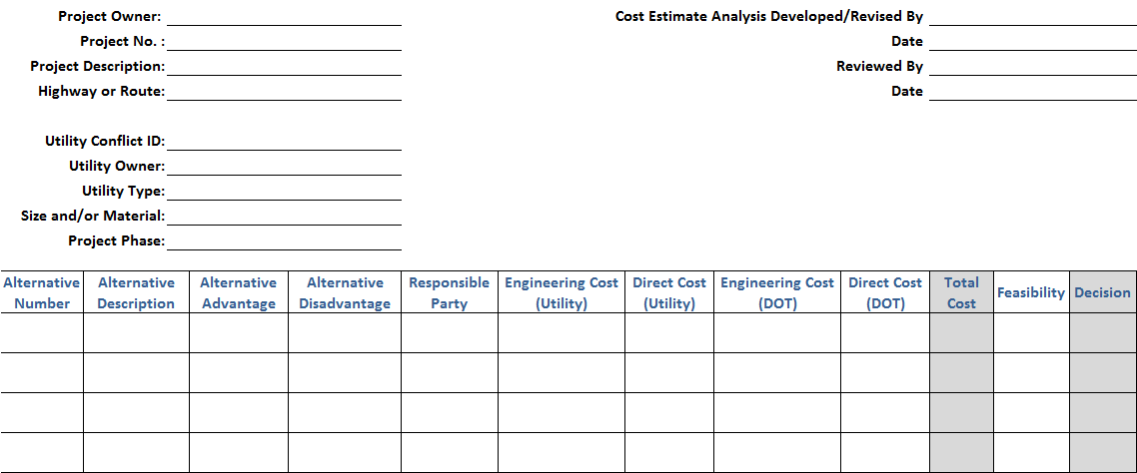
Product 1: Cost Estimate Analysis
MS Excel format, includes drop-down lists
Notes:
One of the data items in the initial version of the standalone UCM was cost estimate. During work sessions with a sample of states to discuss properties and features of the UCM, it became clear that having just one field to capture costs was not adequate. For example, this field would not enable an accurate depiction of which agency would be responsible for which costs. It would also not document the process used to select a utility conflict resolution strategy. This realization resulted in the need to use a second table to analyze costs and other elements associated with each utility conflict resolution strategy. This slide shows the design of the subsheet developed as part of the research.

Slide 26
Product 2: Data Model and Database
Formal data model (ERwin format)
Tested in MS Access
Enterprise database support
(Oracle, SQL Server)
UCM is one of many queries/reports possible
Notes:
As mentioned previously, Product 2 is a data model for managing utility conflicts and a prototype Access database that provides a physical representation of the data model. The data model is generic and was built using industry standard procedures. The data model is in ERwin Data Modeler format, and can be easily exported to a variety of database environments (e.g., Oracle, SQL Server). In this case, the UCM is actually one of many queries or reports possible.
Based on the conceptual model, the researchers developed a logical data model in ERwin consisting of approximately 115 separate entities and numerous relationships. The researchers also produced a prototype physical database in Microsoft Access based on the logical data model, including queries and reports to replicate the standalone Excel UCM as well as a sample of UCMs from around the country. The name of the prototype application was Utility Conflict Database (UCD). The researchers tested the UCM data model by populating the Access database using data from sample documents provided by the states and fine tuning the data model as needed.

Slide 27
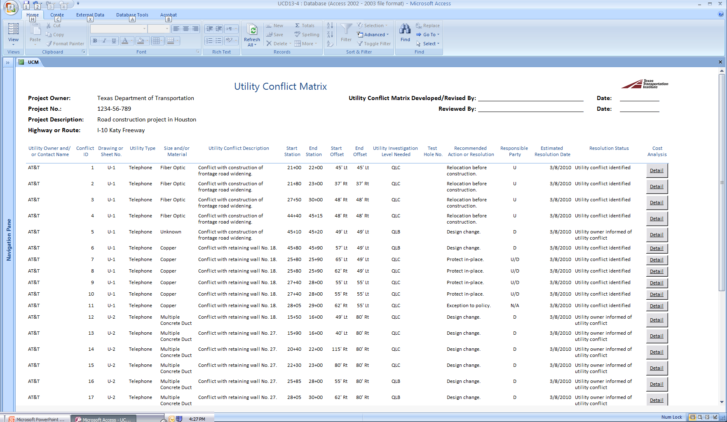
Product 2: Example
Notes:
This slide shows an example utility conflict matrix report in report view generated by the Product 2 database. Note the buttons on the right labeled “Detail,” which provide a link to cost estimate analysis sub reports.

Slide 28
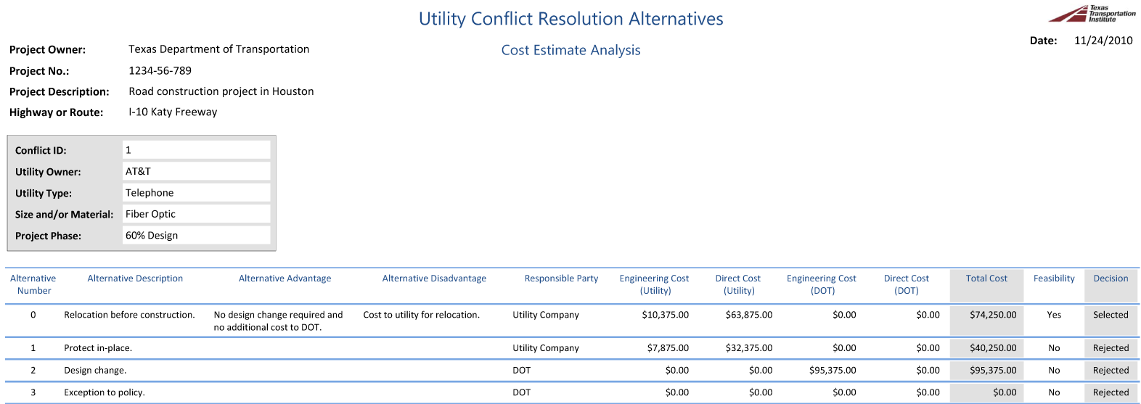
Product 2: Example
Notes:
This slide shows sample records for the cost estimate analysis in connection with the first utility conflict from the previous slide.

Slide 29
Product 2: Other Potential Reports
All utility conflicts associated with company X (project, corridor, or timeframe)
Average conflict resolution time for type X utilities
All utility conflicts with resolution time >100 days
Customized UCMs for individual utility companies
Utility certification for inclusion in PS&E package
Notes:
One of the advantages of using a database approach for the management of utility conflicts is that it is possible to generate all kinds of reports. This slide shows a sample of additional reports that are possible with the prototype database design developed during the research.

Slide 30
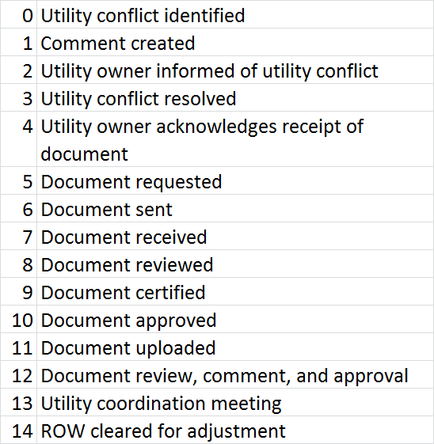
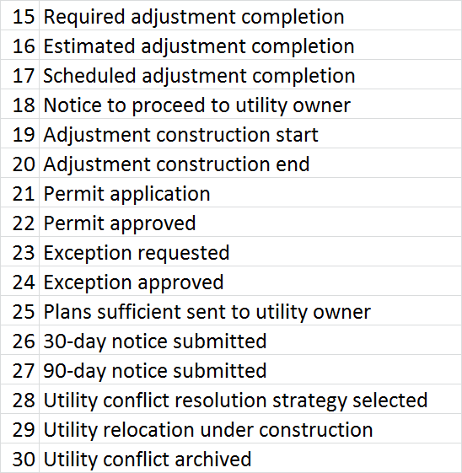
Utility Conflict Event Tracking
Utility conflict created
Utility owner informed of utility conflict
Utility conflict resolution strategy selected
Notice to proceed with utility relocation
Utility relocation start
Utility relocation end
Utility conflict resolved
Notes:
The database also enables users to track critical events (time stamps) occurred in connection with a utility conflict, such as:
Utility conflict created.
Utility owner informed of utility conflict.
Utility conflict resolution strategy selected.
Notice to proceed with utility relocation.
Utility relocation started.
Utility relocation ended.
Utility conflict resolved.
The list of event types is flexible to accommodate the needs of a wide range of DOTs.

Slide 31
One-Day UCM Training Course
Lesson plan (6 lessons)
Presentation materials (PowerPoint)
Presenter notes
Participant handouts
  Handouts, sample project plans, UCM templates
Companion CD
  All training materials, including UCM
  Prototype utility conflict database
Notes:
To assist with the dissemination of the research products, the research team developed a one-day UCM training course that includes the following features:
Lesson plan (6 lessons)
Presentation materials in PowerPoint format
Presenter notes
Participant handouts, including presentation handouts, sample project plans, and UCM templates
Companion CD, which includes all the training materials and a copy of the prototype utility conflict database.
The presentation materials follow NHI presentation templates.

Slide 32
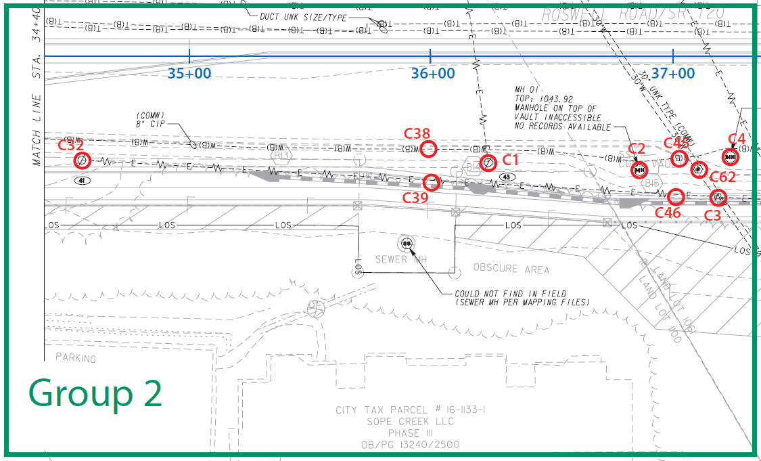
Hands-On Utility Conflict Analysis
Utility Owner | ID | Sheet No. | Utility Type | Size/ Material | Utility Conflict Description | Start Sta. | End Sta. | Start Offset | End Offset | Inv. Need | Test Hole | Recommended Action | Rsp. Party | Est. Res. Date | Res. Status | Cost Analysis
 | C3 | 1 | WM | 30” | Proposed 18” drainage pipe would cross WM. | 37+20 |  | 60’ Rt |  | QLA | 3 | Review possibility of adjusting drainage pipes up to avoid conflict, lowest structure (B13) is at 5.6‘. | D | n/a | Utility conflict identified.
Notes:
A critical component of the UCM training course is the hands-on utility conflict analysis where participants analyze a set of plan sheets and other documentation to identify the location of utility conflicts and use a UCM to document and manage each conflict. At the end of the hands-on exercise, participants are given a copy of the “solution sheet” that shows the location of all utility conflicts (shown here) and sample UCM records.

Slide 33
Implementation Plan
Notes:
This slide shows a preliminary view of the implementation schedule and main activities. For visualization purpose, the figure shows the different components being implemented in parallel. This schedule could easily be modified as needed.

Slide 34
Anticipated Value and Implementation Cost
Implementation Product | Value | Cost
Product 1 (standalone UCM, MS Excel) | 20 | $
Product 3 UCM training course | 40 | $$
Product 2 (standalone implementation, MS Access) | 50 | $$$
Product 2 (enterprise-level implementation) | 80 | $$$$
Notes:
This slide shows the expected value and implementation cost of each product. The standalone Excel UCM template (i.e., Product 1) and the one-day UCM training course (i.e., Product 3) are what could be called “low-hanging fruit.” These two products are ready for implementation, and the corresponding implementation cost is low. By comparison, the UCM data model and database representation (i.e., Product 2), while ready for implementation, would require selecting a system platform and developing graphical user interfaces to enable users to interact with the database. Depending on the level of implementation of this product (e.g., standalone Microsoft Access database versus an enterprise web-based system), the implementation cost and horizon could vary substantially.
Value: Subjective measure of the product’s potential to assist an agency in managing utility conflicts effectively. The value scale is 1 (lowest) to 100 (highest).
Cost: Subjective measure of the anticipated cost to implement a product at a transportation agency. The cost scale is $ (lowest) to $$$$ (highest).

Slide 35
“So What” Questions
What’s different about these new tools?
What new capabilities will they provide?
Will they be more difficult to use?
Will they require special training or operation only by specially-trained people?
How will the costs to use these tools compare with those of today’s tools?

Slide 36
Answers
Systematic treatment of utility conflicts
More effective PDP integration
Easy to use given a correct implementation
Training for all stakeholders is recommended to realize benefits of UCM implementation
Slightly higher front-end costs but potentially much lower costs at the end

Slide 37
Potential Challenges
District project managers might not perceive tangible economic benefit
Lack of financial resources to implement strategy
Inconsistent use of UCMs

Slide 38
Streamlining and Standardization of Utility Cost Data Submissions
Strategy 3

Slide 39
Strategies to Encourage and Facilitate Utility Participation
1. Modernization of the utility process
2. Utility conflict matrix approach
3. Streamlining and standardization of
utility cost data submissions
4. Core skill training on utility topics

Slide 40
Utility Cost Estimate Categories
Direct utility adjustment costs:
  Materials and supplies, labor, overhead, transportation, equipment
Usually handled as separate items:
  Traffic control, right of way
Other cost elements:
  Salvage, abandoned facilities, removal of materials
  Credits
    Betterments (forced vs. elective)
    Capital improvements (in some cases)
Notes:
Most utility agreements at TxDOT follow the traditional cost category-based approach, in which cost estimates must be broken down into different cost categories. Some of the categories are part of the direct cost to complete the relocation in the field (e.g., materials, supplies, equipment, and so on). Other categories are frequently handled separately as separate items (e.g., traffic control and mobilization), although it is also common to include these items as subsidiary items to other cost elements. Cost estimates must also include elements such as salvage and removal of materials as well as betterments and capital improvements (if appropriate).
It is worth noting that federal and state regulations now enable utility owners to submit cost estimates using a quantity-unit cost approach. In practice, most cost estimates are still prepared using the traditional cost category approach.

Slide 41
Notes:
The end result of the cost estimation process is a summary that includes direct costs as well as cost elements such as betterments and eligibility calculations. This slide shows a sample estimate summary. Notice that this table does not provide a disaggregation of direct costs (which the utility owner or its consultant would need to provide to support the numbers shown).
In the example, it is necessary to adjust a 4-inch water main and a 6-inch gravity sewer main. Both facilities are located partly on state right-of-way (1,200 feet) and partly on a private easement (4,800 feet) with a total estimated length of 6,000 feet. The utility owner would like to upgrade the diameter of the water line to 12 inches. To adjust the lines, the utility owner needs to acquire a new easement on private property. Further, the meters used in the original installation no longer comply with local codes and need replacement with an upgraded version that is more expensive. The estimate assumes that mobilization and traffic control costs are included as subsidiary items in the bids for the installation of the water and sewer mains. To calculate the amount eligible for state participation, the utility owner submits an in-kind estimate and a betterment estimate, along with information of the existing utility’s location on public and private rights-of-way. Only the portion of the facility located on the private easement (4,800 feet) is eligible for reimbursement.

Slide 42
Issues with Current Practice
Utility reimbursement practices vary by district
Utility owners handle cost data differently
Utility owners have difficulty understanding and following current procedures
Final billings can be submitted years after adjustment completed
Frequent complaints about requirements
Notes:
Issues related to the current practice for preparing and submitting utility cost data include, but are not limited to, the following:
Utility reimbursement practices vary from district to district.
Utility owners handle cost data in a variety of ways, which means costs may be broken down and submitted in different formats.
Current procedures require billings to match the estimate. However, actual bids for utility work are often different from what utility owners submitted originally for the utility agreement.
Utility owners complain that current requirements for the submission of cost estimates, as described in the ROW Utility Manual, are difficult to understand and follow.
Final billings are frequently submitted years after the adjustment is completed in the field. In other cases, utility owners do not submit final billings at all.
Utility owners frequently complain about documentation requirements, e.g., those associated with partial payments.

Slide 43
Updated Framework for Developing Utility Cost Estimates
Benefits:
Support for cost estimates at various phases during the project development process
Reduction in uncertainty and risk
Less contentious relationship between TxDOT and utility owners
Notes:
Implementing an updated framework for the development of utility adjustment cost estimates with the goal to address limitations in the current process would have a number of benefits, including the following:
Support for the development of utility adjustment cost estimates at various stages in the utility adjustment process.
Reduction in the level of uncertainty and risk for managing utility adjustments at TxDOT.
More effective, less contentious relationship between TxDOT and utility owners.
More effective coordination with the highway project development and delivery process, e.g., for the determination of total project costs and the production of utility cost estimates when the highway contract includes utility adjustments.

Slide 44
Unit Costs vs. Cost Categories
Notes:
Using cost categories or quantities/unit costs should produce the same total cost estimate. In practice, it should be possible to submit utility cost data in ways that facilitate the exchange of information and trend analysis. The most expedited strategy to accomplish this goal is by requiring utility cost data submissions in such a way that it should be possible to easily translate cost category-based information to construction unit cost-based information (and vice versa). The key behind this assumption is to divide the project into tangible construction items that can be managed in the field.
Table (a) shows a cost estimate disaggregated by items and cost categories. For simplicity, the table only shows five categories (materials, labor, overhead, transportation, and equipment), although additional cost categories could be added. Table (b) shows the same cost estimate disaggregated by items, quantities, and unit costs. Notice how the total cost associated with each item (last column) is the same regardless of the procedure to develop the cost estimate.

Slide 45
Cost Estimate Progression
Notes:
A critical cost element that is frequently ignored is related to contingencies. In general, contingencies tend to decrease throughout the project development process. As a result, there is a progression of milestones where the methodology to produce utility adjustment costs could change depending on the information available. Although each particular utility adjustment is different, this figure provides a roadmap for the production of utility cost estimates that takes into consideration both pre-contract contingencies and post-contract contingencies at different phases in the utility adjustment process. The percentages shown in the figure correspond to contingency levels that are commonly used in the highway construction industry.

Slide 46
Prototype Utility Cost Estimate Submission Forms
Microsoft Excel file with four integrated worksheets
  Items
  Unit Cost Analysis
  Item Disaggregation Analysis
  Cost Category Summary
Open PDF File
Notes:
To assist in the process of submitting standardized utility cost estimates, the researchers prepared a Microsoft Excel file with four integrated worksheets.
Clicking the Open PDF File button loads a PDF file representation of the utility cost estimate template. This file is located in the \Strategy 3 - Standardization of Utility Cost Data Submissions\ folder. The folder also includes the template in Microsoft Excel format. Notice that the Excel file contains macros, hence the .xlsm file extension.

Slide 47
Items Worksheet
Notes:
The Items worksheet enables utility owners to add a list of items. These items represent logical divisions of work in the field. Ideally, the list of items should be the result of cooperation between the utility owner and TxDOT to ensure a utility adjustment project is divided into manageable pieces of work that facilitate the development of reliable cost estimates and monitoring of construction activities in the field. A useful strategy to achieve this goal is to use construction specifications as a tool to define items. In many cases, the utility owner already has a set of construction specifications (either standard or special) that could be used for that purpose. Alternatively, a suitable construction specification might be available at TxDOT or from an external source.
This slide shows items associated with the adjustment of a water main. In this case, the utility owner provided quantities and unit costs for each item, which enabled the use of the Unit Cost Analysis Worksheet directly (see next slide). Each item in the table corresponds to a construction item in the field (with the exception of engineering fees, for which the utility owner provided a separate tabulation disaggregating engineering charges into seven categories and travel.

Slide 48
Unit Cost Analysis Worksheet
Notes:
The Unit Cost Analysis worksheet enables utility owners to provide utility cost data using a unit cost approach. With this approach, users load the list of items from the Items worksheet and provide unit, quantity, and unit cost data for each item. The worksheet automatically calculates the total cost for each item and for the entire project.
This slide shows the list of items, units, quantities, and unit costs for the example shown in the previous slide.
Notice that this worksheet is not mandatory because utility owners have the option to use a cost category approach to develop cost estimates. However, if users also provide cost category data, the Unit Cost Analysis worksheet enables users to validate unit cost data by importing total dollar amounts per item from the Item Disaggregation Analysis worksheet and by developing a separate “validated” unit cost estimate.

Slide 49
Items Worksheet (Example 2)
Notes:
This slide shows items associated with the adjustment of an electric transmission line. In this case, the utility owner did not provide quantities and unit costs for each item. Instead, the utility owner provided disaggregated cost data for each item by cost category, which made it necessary to use the Item Disaggregation Analysis Worksheet (see next slide).

Slide 50
Item Disaggregation Analysis Worksheet
Notes:
The Item Disaggregation Analysis worksheet enables utility owners to provide utility cost data using a cost category approach. With this approach, users load the list of items from the Items worksheet and provide disaggregated component information for each item according to one or more of the following cost categories: materials and supplies, labor, overhead, and transportation and equipment. For each component, users provide unit, quantity, and unit rate (or unit price). The worksheet automatically calculates the total cost for each component, for each item, and for the entire project.
For this example, the utility owner provided a highly disaggregated list of materials for the pole assemblies (down to the quantity and unit cost for each individual bolt, nut, rod, and so on), but did not indicate which components were associated with each type of pole (90-ft versus 95-ft). For simplicity, the slide shows the total dollar amount for these materials equally divided by two for each type of pole. Similar considerations apply to other cost categories, where the utility owner provided total costs but did not disaggregate them by type of pole (90-ft versus 95-ft).
This worksheet is not mandatory because utility owners have the option to use a unit cost approach to develop cost estimates. However, if users also provide unit cost data, the Item Disaggregation Analysis worksheet enables users to import total dollar amounts per item from the Unit Cost Analysis worksheet.

Slide 51
Cost Category Summary Worksheet
Notes:
The Cost Category Summary worksheet enables utility owners to prepare a summary tabulation of the cost items provided in the Item Disaggregation Analysis worksheet. All cost data elements come from this worksheet, which means that users do not need to enter any data manually.
This slide shows a summary of category costs for the example shown in the previous two slides.

Slide 52
Notes:
A key requirement in the standardization of utility cost data submissions is the use of construction specifications that match the list of items included in the cost estimate.
If the utility owner does not already have a set of construction specifications, it would be necessary to develop it. As part of TxDOT research project 0-4998, the researchers developed a general framework for utility specifications at TxDOT that mimics all the components of a typical highway construction specification. The researchers developed templates for a wide range of utility specifications, including water, sanitary sewer, electric, and communication installations. As an illustration, this slide shows the proposed template for the installation of ground boxes. The generic template is a modified version of TxDOT Form 1814. For each specification, the research team also prepared a set of specification requirements, which could be used to develop the full construction specification following the 2004 TxDOT specification standard.

Slide 53
Implementation Plan
Select district for pilot implementation
Implement two-day training course on utility cost estimation procedures
Update ROW Utility Manual
Standardize the preparation and submission of utility cost estimates statewide
Notes:
The researchers recommend the following major steps to implement the strategy:
Select a sample district to pilot the use of the Excel-based template for the submission of utility cost data estimates by utility owners. The pilot test would likely involve one or more projects and include monitoring how users react to the various components of the template. Based on user feedback, an updated version of the template might be developed, as needed.
Develop and pilot a two-day training course on the preparation of utility cost estimates. Stakeholders would include TxDOT officials, consultants (both highway and utility), and utility representatives.
Capture feedback from districts and update the ROW Utility Manual to reflect the updated, streamlined process to prepare and submit utility cost estimates.
Standardize the preparation and submission of utility cost estimates throughout the state based on the experience gathered with the pilot implementation above.

Slide 54
Potential Challenges
Users might decide to continue to use existing (familiar) procedures
Utility owners might see conflict with their current accounting methods
Lack of resources to implement strategy

Slide 55
Core skill training on utility topics
Strategy 4

Slide 56
Strategies to Encourage and Facilitate Utility Participation
1. Modernization of the utility process
2. Utility conflict matrix approach
3. Streamlining and standardization of utility
cost data submissions
4. Core skill training on utility topics

Slide 57
Training Needs
TxDOT
  Utility coordinators
  Design engineers, project managers, area engineers
  Right of Way Division officials
  Construction inspectors
Utility Owners
  Executive level, design staff, field staff
Consultants and contractors
  Transportation, utility coordination, utility investigations
Notes:
The need for training of staff involved in utility-related activities in the project development and delivery process was a common theme during discussions with various TxDOT district staff, utility owners, and other stakeholders. Training needs are not limited to staff who normally interact with utility owners, e.g., utility coordinators and right of way agents, but extend to staff whose work is likely to be affected by utility issues, such as project managers, design engineers, area engineers, and even planners. The need for training needs also extends to highway and utility consultants and contractors.

Slide 58
Training Topics
TxDOT project development process
  TxDOT project development and delivery process
  TxDOT design plans and specifications
Utility process from utility owner’s perspective
  Utility project development and delivery process
  Utility design plans and specifications
Utility coordination
  Federal and state laws and regulations
  Utility coordination process
Notes:
The researchers identified several categories where the need for training opportunities to address the needs of stakeholders in the area of utility coordination was the greatest. Within each category, the researchers identified specific core skills that could serve as the foundation for proposed training courses or modules and identified a basic set of requirements for different levels of instruction. For each level of instruction, the researchers estimated the minimum number of training hours required to provide a basic level of understanding of the topic under consideration.

Slide 59
Training Topics
Utility coordination (continued)
  Memoranda of understanding
  Utility investigations
  Utility conflict management
  Utility adjustment cost estimates
  Utility agreement assemblies
  Using ROWIS to manage utility adjustments
Utility permitting
  Preparation, submission, and review of utility permits

Slide 60
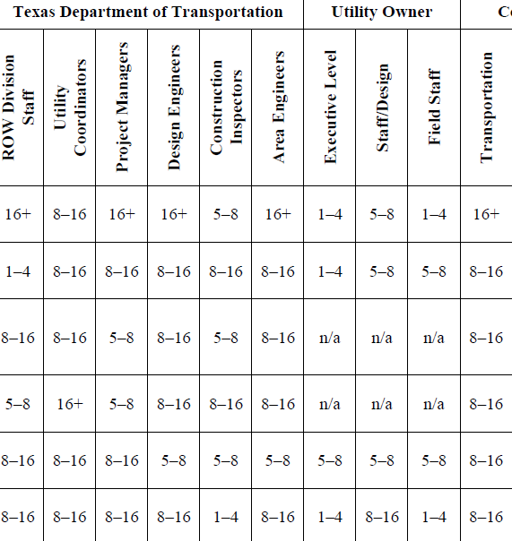
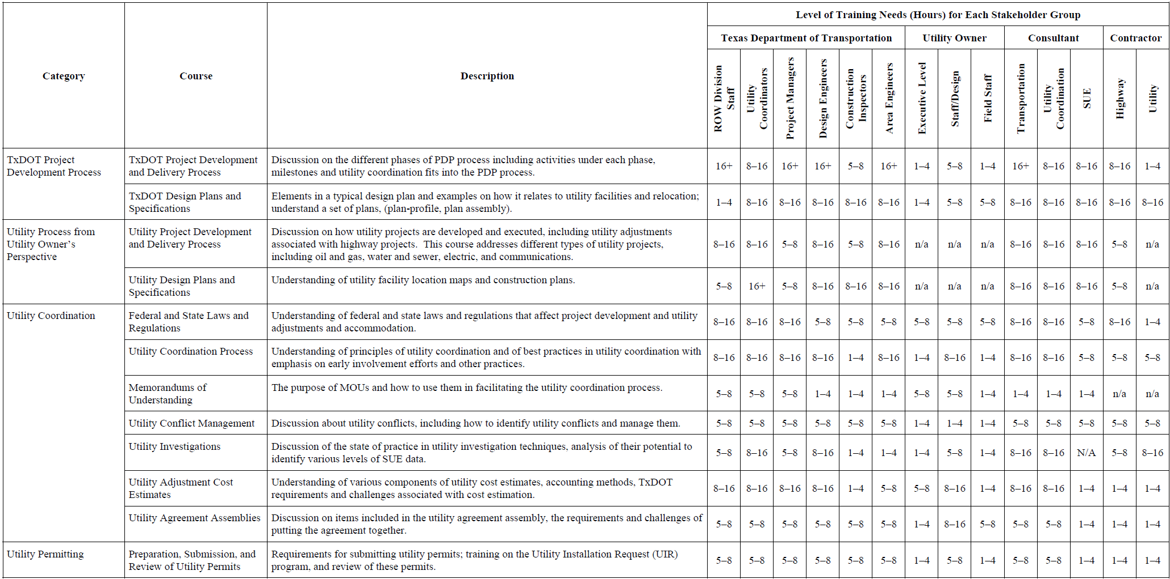
Training Topics
Open PDF File
Notes:
This table summarizes the various categories, core skills, brief course description, and a preliminary assessment of minimum number of training hours for each stakeholder group.

Slide 61
Implementation Plan
Schedule one-day training courses to disseminate the use of UCMs
Develop one-day training course for the updated depiction of the utility process
Develop two-day training course on the preparation of utility cost estimates
Develop other training courses following a systematic approach
Notes:
The researchers recommend the following major steps to implement the various training courses or modules identified in the previous section:
Schedule one-day training courses to disseminate the systematic use of UCMs in the project development process. The one-day UCM training course, which was developed as part of project SHRP 2 R15-B, is ready for deployment. The course content could be easily customized to suit TxDOT needs, as needed.
Develop and pilot a one-day training course or module to describe the updated depiction of the utility process at TxDOT that was developed as part of the research.
Develop and pilot a two-day training course on the preparation of utility cost estimates. This course would use the Excel-based template developed as part of the research as a central component and would enable participants to learn how to develop cost estimates for a variety of project conditions.
Develop and pilot other training courses following a systematic approach that includes conducting a survey of user needs and takes into consideration factors such as availability of existing courses that could be updated to address relevant utility issues and financial constraints.

Slide 62
Potential Challenges
Financial constraints
Perception of benefits
Notes:
Developing and delivering training requires committing resources that might not be immediately available or that compete against other priorities. While significant, one way to address this challenge is by making the business case that investing in utility-related training can result in short-term and long-term benefits to the department in the form of more effective communication and coordination with utility owners, fewer delays, and fewer opportunities for cost overruns and utility-related change orders and claims.
Some stakeholders might not be convinced that developing and delivering training on utility topics is worth the investment. One way to address this issue would be by providing training (with examples) to project managers, planners, designers, and utility owners on the benefits that can be realized by considering utility conflicts early in the project development phase.

